Slide 1
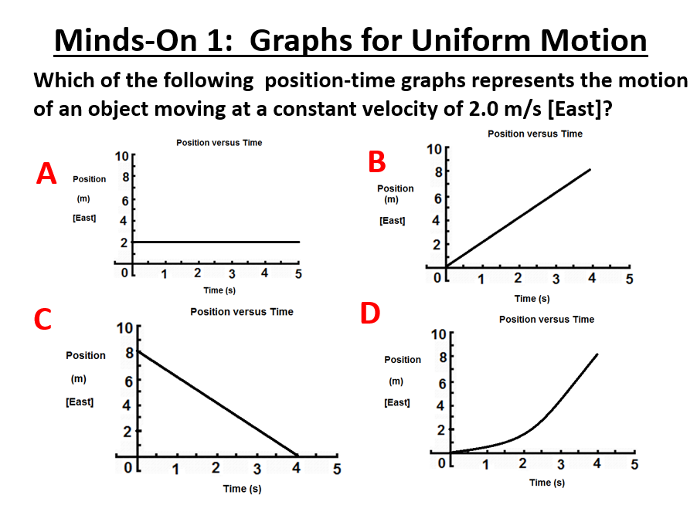
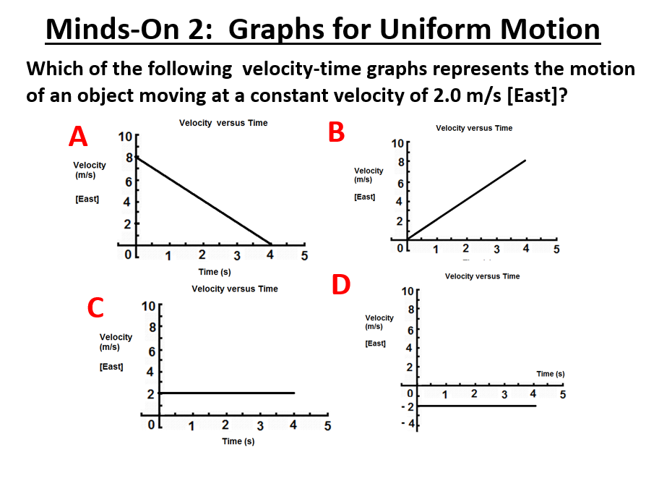

Slide 2
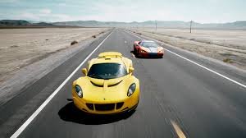
Graphs for Uniform Motion: D-T to V-T analysis
Uniform Motion:
●
●
Example: a car travelling on a straight highway
at 100 km/h [West]

Slide 3
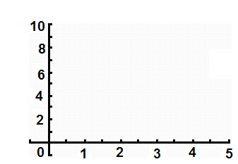
Position-Time Graph
Example: Consider a person walking at a constant velocity of 2.0 m/s [East]. How will the position-time graph of their motion appear?
Time (s) | Position from origin (m) [E]
0.0 | 0.0
1.0
2.0
3.0
4.0
5.0
Position vs. Time
Position (m) [E] of origin
Time (s)

Slide 4
Finding Velocity from a Position –Time Graph
Velocity = slope of position-time graph
Position vs. Time
Velocity = Δd
Δt
●
●
●
Position (m) [E] of origin
●
●
●
Time (s)

Slide 5
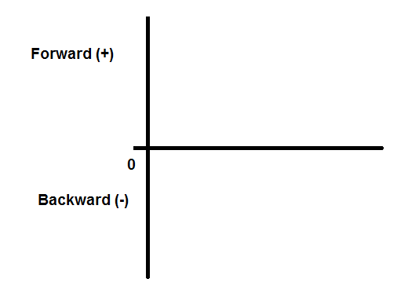
Examples of Motion:
1) Starting at the origin, moving forward and then coming to a stop!
2) Starting from behind origin, moving forward past origin at constant velocity and then coming to a stop!

Slide 6
Examples of Motion:
3) Starting in front of origin, moving backwards past origin at constant velocity
4) Starting in front of origin, moving backwards but coming to a stop before reaching the origin, then moving forward.

Slide 7
Examples of Motion:
5) Two cars, A and B, moving forward from origin at constant velocity- A moving faster than B!
6) A toy car moves forward from origin at a constant velocity, stops for a moment, then turns around and returns to the origin at a higher speed!

Slide 8
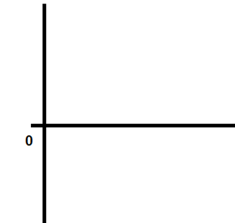
Velocity-Time Graphs for Uniform Motion
An object is moving forward at a constant velocity of 2.0 m/s [Forward] from the origin. How does the velocity –time graph appear?
Position versus Time
Velocity versus Time
Position (m) [E]
Velocity (m/s) [E]
Time (s)
Time (s)
The velocity is constant!
●

Slide 9
Velocity –Time Graph for Backward Motion
An object is moving at a constant velocity of 2.0 m/s [Backward]. How does the velocity –time graph appear?
Position versus Time
Velocity versus Time
Position (m) [E]
Velocity (m/s) [E]
Time (s)
Time (s)
Let: Forward = + , Backward= - ….. Then the velocity is -2.0 m/s!
●

Slide 10
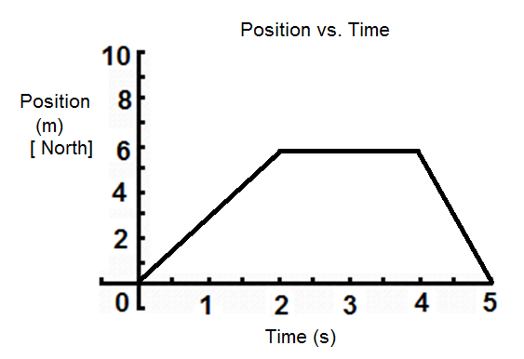
Example: Calculate the slopes of each segment of the
D-T graph below and draw the corresponding V-T graph.

Slide 11
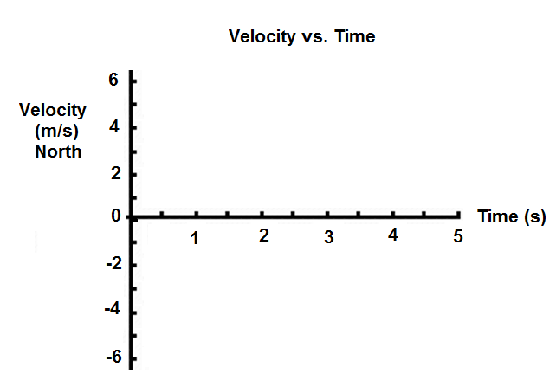
Solution:

Slide 12
Summary:
Constant velocity in the forward (positive) direction looks like a
_____________________ on a position-time graph.
2. Constant velocity in the forward (positive) direction looks like a
_____________________ on a velocity-time graph.
3. To find the velocity from a position-time graph for uniform motion
you take the _____________________.

